Slide 1

Open-Source Lunch Bites
Thursday 15th October 2026

Slide 2
Introduction
Open-Source Lunch Bites is a series of 30-minute monthly (3rd Thursday) webinar lunch and learns designed to provide practical, bite-sized learning experiences.
Each session includes a presentation/demonstration with space for interaction and questions as necessary, focusing on Open-Source skills relevant to the pharmaceutical industry.
The webinars will have tied-in resources for ongoing learning.
Join us each month to enhance your Open-Source knowledge in a convenient, pocket-sized format.

Slide 3
Topics
Why Open-Source Skills are Important – PSI AIMS SIG Website
Coding
Debugging
Packages
GitHub
Containers
AI use
Suggestions?

Slide 4
So Far…
What is an IDE?
Debugging
Package Basics (parts 1 and 2)
Graphics Basics (parts 1, 2 and 3)
Quarto Basics (part 1)
Code and presentations – website/lunchbites at main · PSIAIMS/website
Quick summaries – News – PSI AIMS SIG Website

Slide 5
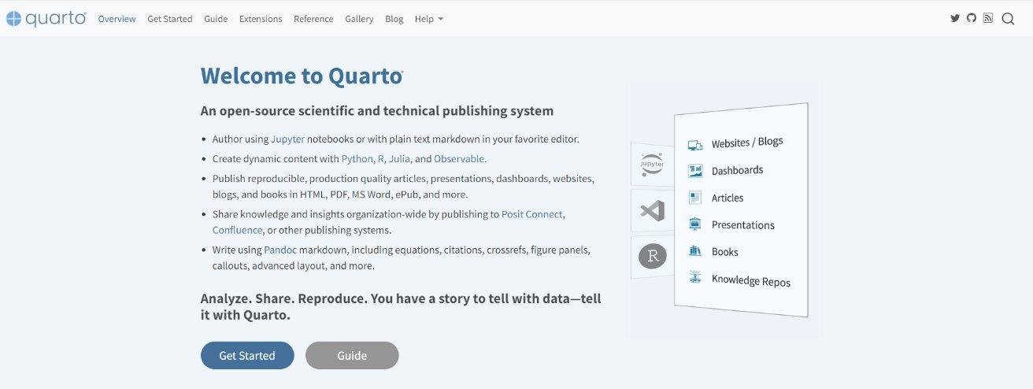
Quarto Basics
Link – Quarto
Quarto is a multi-language, next generation version of R Markdown from Posit, with many new features and capabilities.
R Markdown is fundamentally tied to R which severely limits the number of practitioners it can benefit.
Quarto is Posit’s attempt to bring R Markdown to everyone!
Quarto was developed to be multilingual, beginning with R, Python, Javascript, and Julia, with the idea that it will work even for languages that don’t yet exist.

Slide 6
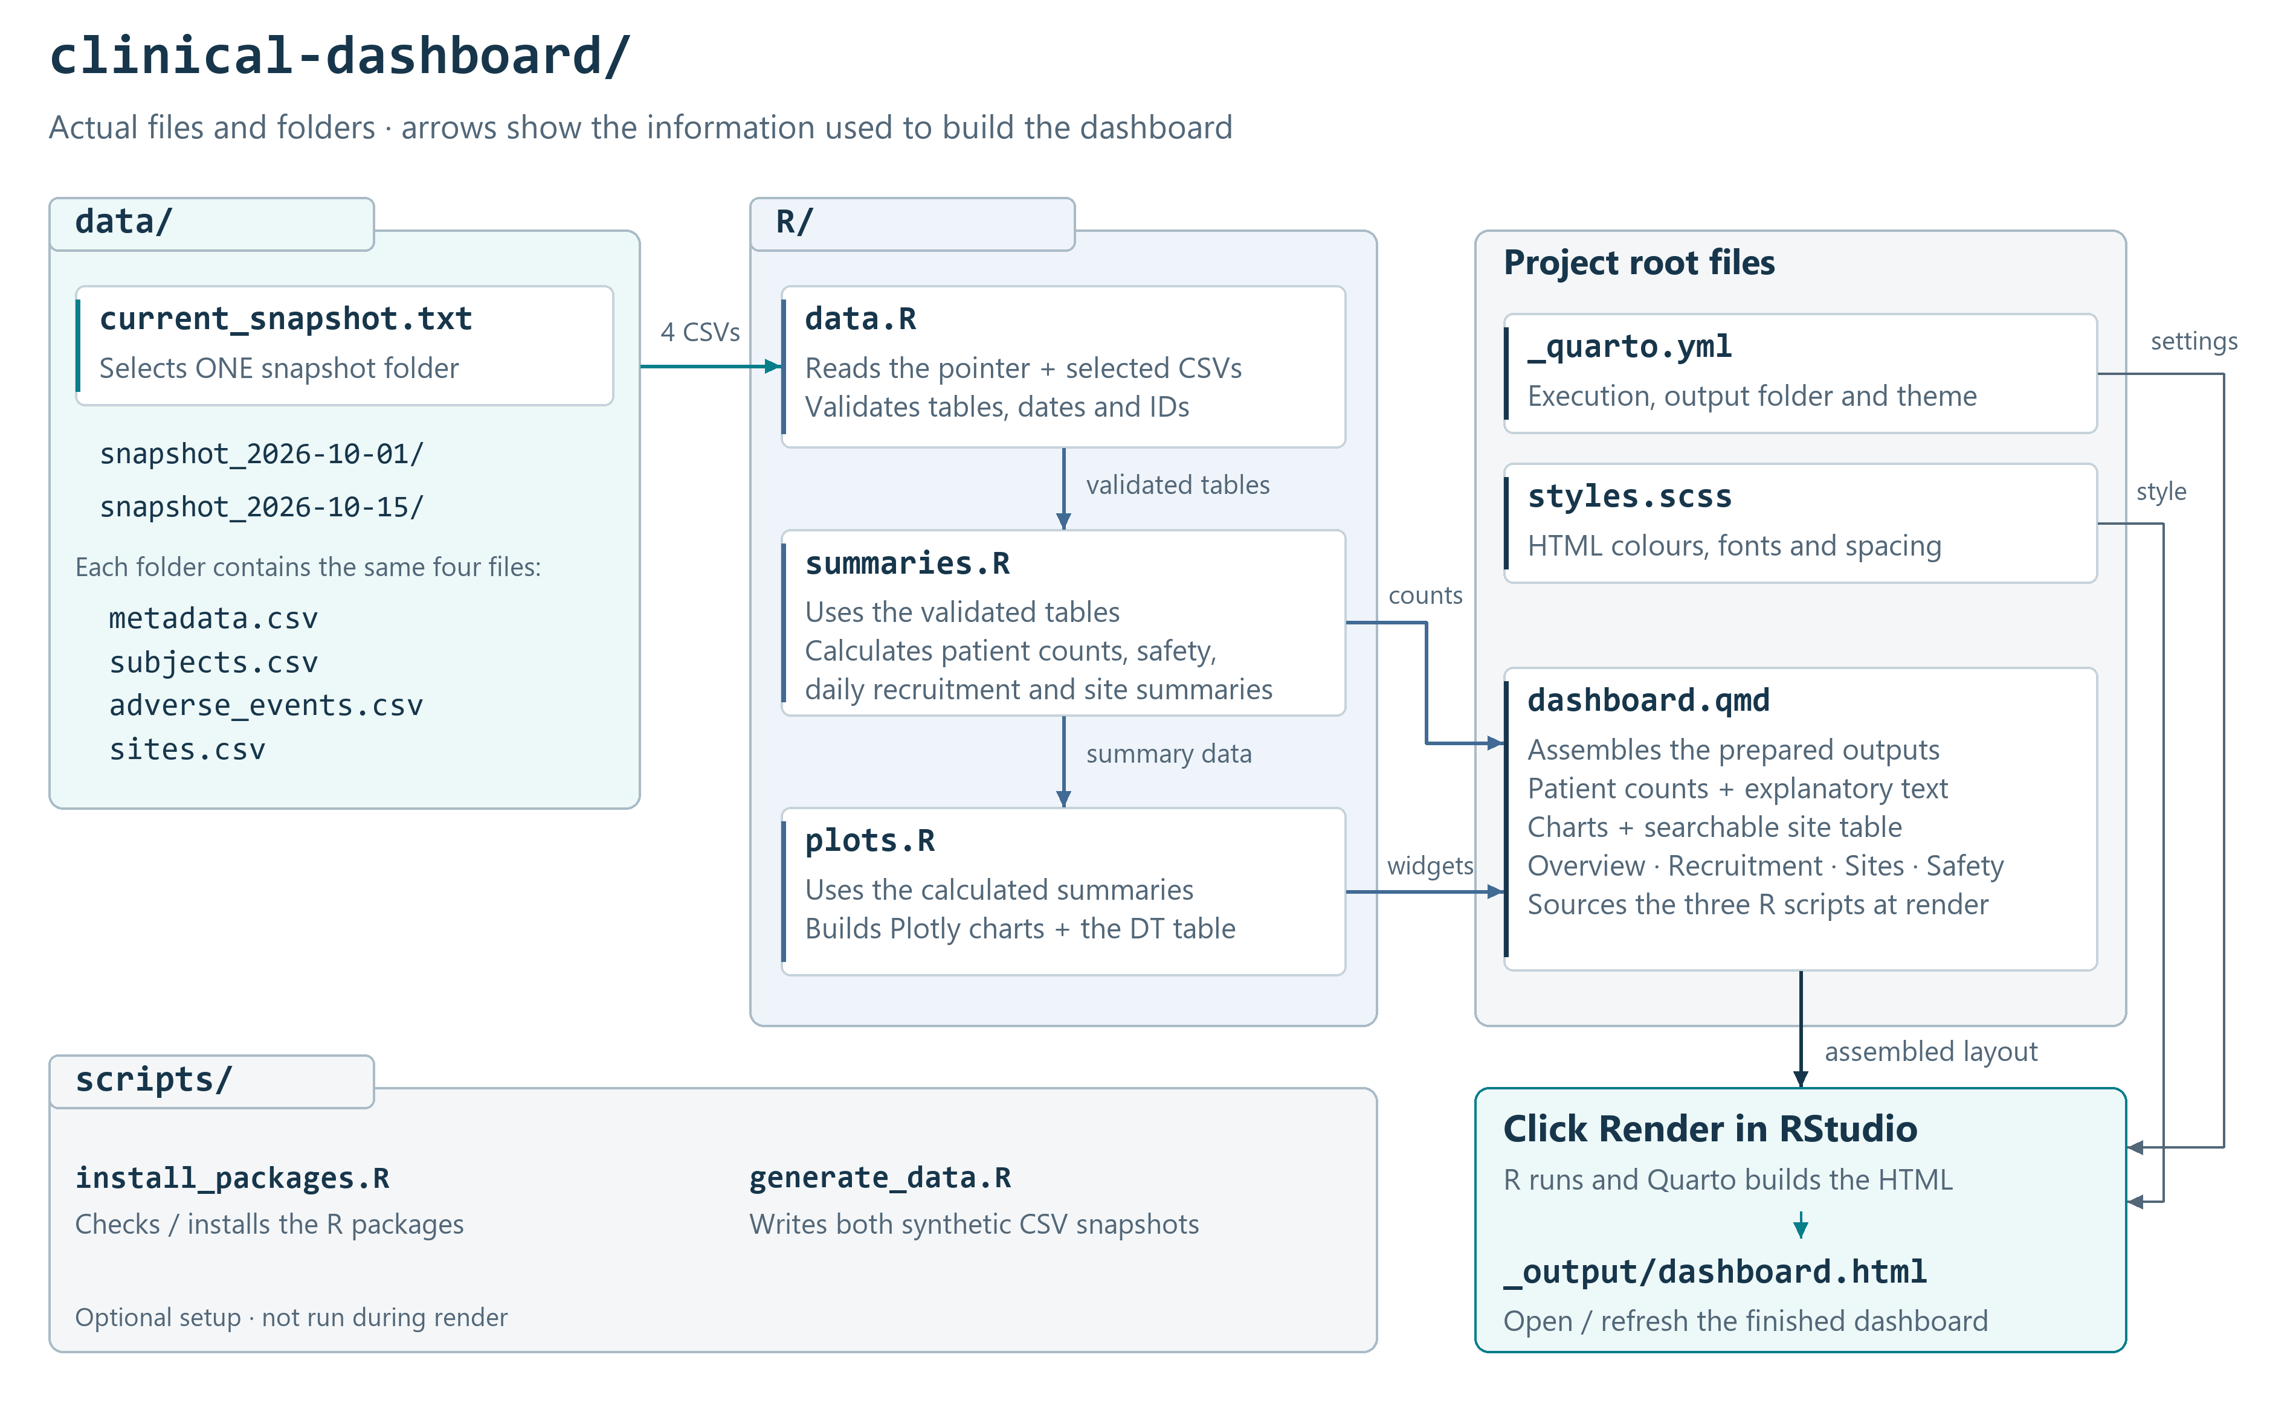
Quarto Basics 2
Structured Quarto Dashboard: Update the Data, Refresh the Insights
Files -
website/lunchbites/quarto-basics-2 at main · PSIAIMS/website

Slide 7
Quarto Basics 2
Links
Quarto
https://quarto.org/docs/dashboards/layout.html#cards
Build-a-Dashboard Workshop
Mickaël CANOUIL, Ph.D. – Mickaël CANOUIL
Clinical Study Report

